Slide 1

FitPro AI : Fitness chatbot using OPEN AI
By
Krishna Dongre (22106089)
Tanveer Angane (22106057)
Siddharth Chaurasiya (22106060)
Anish Gawade (22106109)
Under the Guidance of
Prof. Sayali Badhan

Slide 2
OUTLINE
INTRODUCTION
LITERATIVE SURVEY OF THE EXISTING SYSTEMS
LIMITATIONS OF THE EXISTING SYSTEM
PROBLEM STATEMENT
SYSTEM DESIGN
TECHNOLOGIES AND METHODOLOGIES
IMPLEMENTAION
CONCLUSION
REFERENCES

Slide 3
INTRODUCTION
Imagine having a fitness companion that knows your goals, understands your preferences, and guides you through your workout journey.
This project will help users to personalize their gym routine based on their physique.
We will make this a one stop destination for all your gym related queries.
Preselected routine plus video demonstrations for beginners to avoid serious injuries.

Slide 4
MOTIVATION
Rising Health Awareness: A growing number of people are prioritizing health and fitness, seeking ways to lead healthier lives.
Accessibility: Traditional gym facilities are not always easily accessible or affordable. Our project aims to bring the gym experience to anyone with an internet connection.
AI Advancements: The advancements in artificial intelligence have opened up new possibilities in the fitness sector. Our motivation stems from harnessing AI to create a virtual gym trainer capable of offering intelligent workout recommendations and guidance.

Slide 5
OBJECTIVE
This project aims to address the following key objectives:
Enhance Accessibility
Real-Time Guidance
Security and Privacy:
Cost-Effective Solution

Slide 6
LITERATIVE SURVEY
SR. NO.
PAPER NAME
AUTHORS
PROS
CONS
1) Whatsapp chatbot makes interactions between man and machines using natural language possible.
2) WhatsApp developers will not detect any robots that are sending messages automatically.
1) WhatsApp's Chatbot features are constrained due to integration with its API for business enterprise.
2) Chatbot simulations are limited to sending to a maximum of 15 contacts, prioritizing top or recent chats.
Achmad Ramaditiya, Suci Rahmatia, Aris Munawar, Octarina Nur Samijayani Electrical Engineering Department University of Al Azhar Indonesia
Implementation Chatbot Whatsapp using Python Programming for Broadcast and Reply Message Automatically
1.

Slide 7
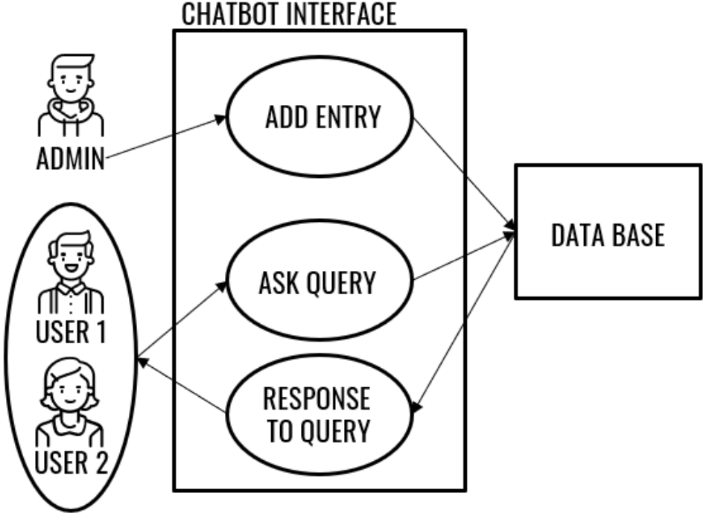
PAPER NAME
Proposed System
SR. NO.
Implementation Chatbot Whatsapp using Python Programming for Broadcast and Reply Message Automatically

Slide 8
LITERATIVE SURVEY
SR. NO.
PAPER NAME
AUTHORS
PROS
CONS
1) Tailored Customization: The app allows users to personalize workout plans based on goals and resources, promoting engagement.
2) Versatile Approach: Unlike rivals, the app caters to various workout preferences and objectives, widening its potential audience.
1) Differentiation Challenge: Unique features that set the app apart from competitors aren't clearly highlighted.
2) User Feedback Depth: While testing feedback is positive, more specifics on user suggestions and challenges could enhance app refinement.
Hoshang Kolivand, Edward Green, Shiva Asadianfam, Department Computer Science Liverpool John Moores University Liverpool, UK
A Fitness App to Fit Everybody’s Schedule
2.

Slide 9
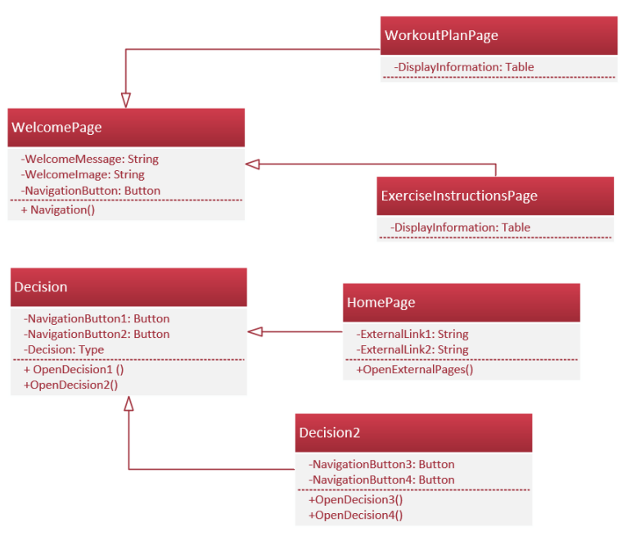
SR. NUMBER
PAPER NAME
Proposed System
A Fitness App to Fit Everybody’s Schedule

Slide 10
LITERATIVE SURVEY
SR. NO.
PAPER NAME
AUTHORS
PROS
CONS
1) Accurate Tracking: The combination of AI, motion capture, and wearable devices can provide precise and real-time tracking of body movements, ensuring accurate monitoring of exercises.
2) Feedback and Guidance: The application can offer instant feedback on form, posture, and exercise execution
1) Cost: The implementation of a comprehensive system involving AI, motion capture, and wearable devices can be expensive
2) Technical Issues: Like any technology, the system may encounter technical glitches, connectivity issues, or bugs that can disrupt the user experience and reliability of the application.
Exploring the Application of Artificial Intelligence in Sports Training
3.
Huihua Chen

Slide 11
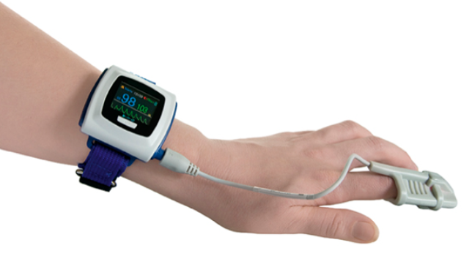
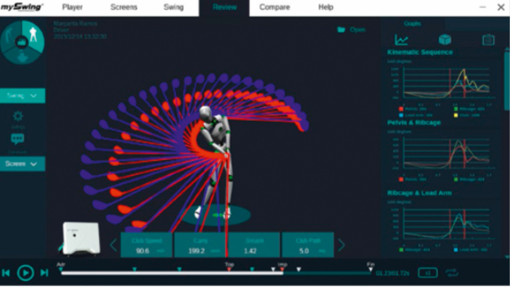
SR. NUMBER
PAPER NAME
Proposed System
Exploring the Application of Artificial Intelligence in Sports Training

Slide 12
LITERATIVE SURVEY
 |  | Alireza Farrokhi Reza Farahbakhsh Javad Rezazadeh Roberto Minerva
SR. NO.
PAPER NAME
AUTHORS
PROS
CONS
1) Real-time Feedback: Allows for instant monitoring of exercise routines and health metrics. ensuring accurate monitoring of exercises and activities.
2) Personalization: Gathers individual metrics and preferences.
Data Security: Vulnerabilities in the IoT ecosystem may pose security risks.
Dependency on Connectivity: Relies on a stable internet connection for data transmission..
Application of Internet of Things and artificial intelligence for smart fitness
4.

Slide 13
SR. NO.
PAPER NAME
Proposed System
IoT Sensors
Data Transmission
Data Transmission
`
Application of Internet of Things and artificial intelligence for smart fitness
Wearables Integration
User Interface
Cloud-based AI Processing:
Feedback Loop

Slide 14
PROBLEM STATEMENT
Limited Access: Many individuals lack access to a nearby gym or fitness center, inhibiting their ability to engage in regular physical activity.
High Costs: Gym memberships, personal trainers, and fitness classes can be expensive, creating financial barriers
One-Size-Fits-All Approach: Generic workout plans do not cater to individual fitness levels, goals, or preferences, resulting in inefficient and demotivating fitness experiences.

Slide 15
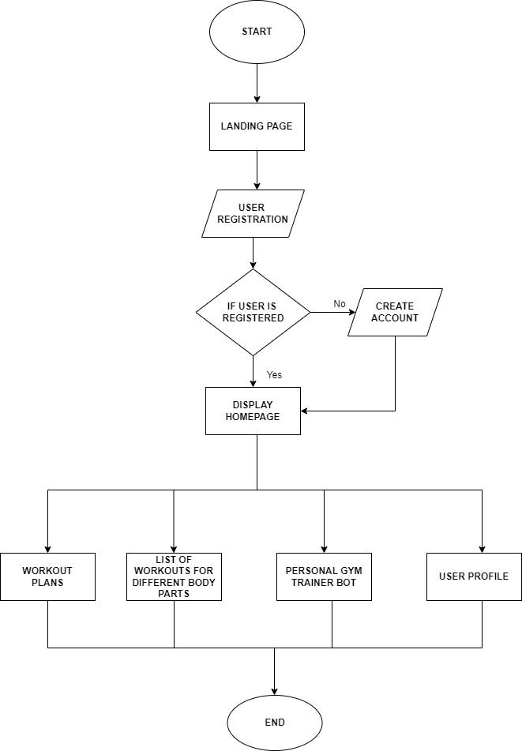
SYSTEM DESIGN:

Slide 16
Technology used:
CLOUD
FRONT END
HTML, CSS
BACK END
JAVA SCRIPT, PYTHON
CLOUD
STREAMLIT
API
OPENAI 3.5 TURBO

Slide 17
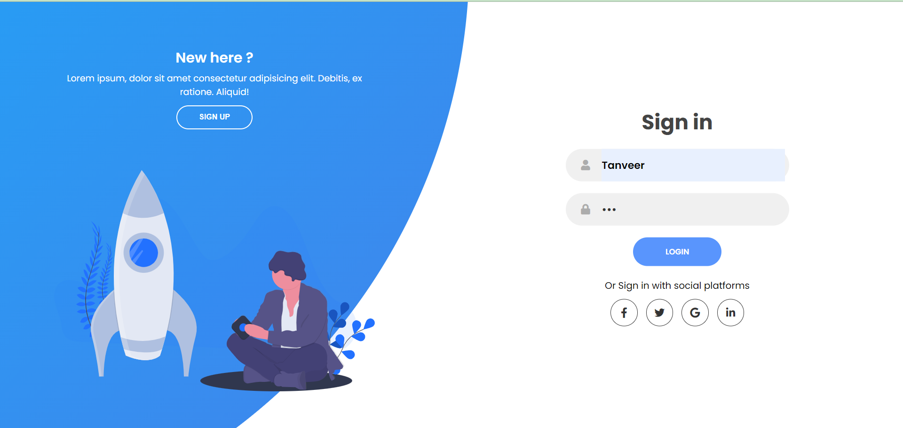

Slide 18
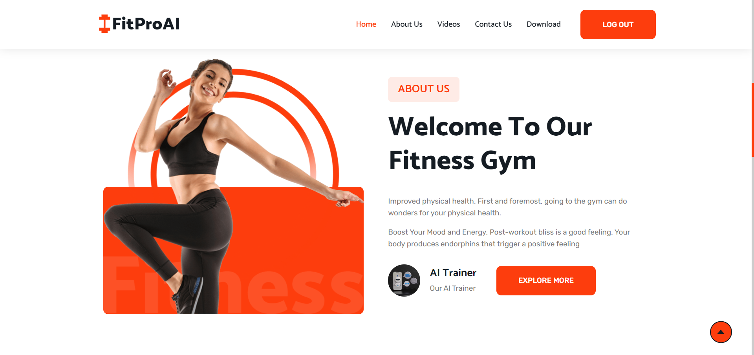

Slide 19


Slide 20
REFERENCE
Ramaditiya, Achmad, et al. "Implementation chatbot whatsapp using python programming for broadcast and reply message automatically." 2021 International Symposium on Electronics and Smart Devices (ISESD). IEEE, 2021. [1]
Kolivand, Hoshang, Edward Green, and Shiva Asadianfam. "A Fitness App to Fit Everybody's Schedule." 2021 14th International Conference on Developments in eSystems Engineering (DeSE). IEEE, 2021. [2]
Wei, Shiqing, et al. "Exploring the application of artificial intelligence in sports training: a case study approach." Complexity 2021 (2021): 1-8. [3]
Farrokhi, Alireza, et al. "Application of Internet of Things and artificial intelligence for smart fitness: A survey." Computer Networks 189 (2021): 107859. [4]

Slide 21
CONCLUSION-
Users can access the AI gym trainer, powered by Streamlit, for personalized workout plans and fitness guidance.
An extensive library of workout plans and exercises is available for users to explore, enhancing their fitness journey.
The project follows a responsive design, enabling users to access it from various devices.

Slide 22
Thank You!!!

